Slide 1
Chapter 2
Operating System Structures

Slide 2
Chapter 2: Operating System Structures
Operating System Services
User Operating System Interface
System Calls
Types of System Calls
System Programs
Operating System Design and Implementation
Operating System Structure
Virtual Machines
Operating System Generation
System Boot

Slide 3
Objectives
To describe the services an operating system provides to users, processes, and other systems
To discuss the various ways of structuring an operating system
To explain how operating systems are installed and customized and how they boot

Slide 4
2.1 Operating System Services

Slide 5
Operating System Services
One set of operating system services provides functions that are helpful to the user
  User interface - Almost all operating systems have a user interface (UI)‏
    Varies between Command-Line (CLI), Graphics User Interface (GUI), Batch
  Program execution - The system must be able to load a program into memory and to run that program, end execution, either normally or abnormally (indicating error)‏
  I/O operations - A running program may require I/O, which may involve a file or an I/O device.
  File-system manipulation - The file system is of particular interest. Obviously, programs need to read and write files and directories, create and delete them, search them, list file Information, permission management.
(More on next slide)

Slide 6
Operating System Services (Cont.)‏
  Communications – Processes may exchange information, on the same computer or between computers over a network
    Communications may be via shared memory or through message passing (packets moved by the OS)‏
  Error detection – OS needs to be constantly aware of possible errors
    May occur in the CPU and memory hardware, in I/O devices, in user program
    For each type of error, OS should take the appropriate action to ensure correct and consistent computing
    Debugging facilities can greatly enhance the user’s and programmer’s abilities to efficiently use the system

Slide 7
Operating System Services (Cont.)‏
Another set of operating system services are used for ensuring the efficient operation of the system itself via resource sharing
  Resource allocation - When multiple users or multiple jobs are running concurrently, resources must be allocated to each of them
    Many types of resources - Some (such as CPU cycles, main memory, and file storage) may have special allocation code, others (such as I/O devices) may have general request and release code.
  Accounting - To keep track of which users use how much and what kinds of computer resources
  Protection and security - The owners of information stored in a multi-user or networked computer system may want to control use of that information, concurrent processes should not interfere with each other
    Protection involves ensuring that all access to system resources is controlled
    Security of the system from outsiders requires user authentication, extends to defending external I/O devices from invalid access attempts

Slide 8
2.2 User Operating System Interface

Slide 9
The Command Line Interface
There are two fundamental approaches for users to interface with the operating system: command line interface and graphical user interface
The command line interface, or command interpreter, allows users to directly enter commands to be performed by the operating system
  Part of the interface is implemented in the form of a single shell program; the other part is implemented as system programs
  There are various kinds of shell programs (C shell, Bourne shell, korn shell, etc.)‏
  The interface fetches a command from the user and executes it
uxb2% pwd
/home/jjt107/http/cs410
uxb2% date
Tue Aug 15 12:49:41 CDT 2006
uxb2%

Slide 10
The Graphical User Interface (GUI)‏
A graphical user interface (GUI) provides a mouse-based interface consisting of windows and menus
Depending on the position of the mouse cursor, clicking on a mouse button can invoke a program, select a file or directory, or pull down a menu that contains commands
Graphical user interfaces first appeared because of the research that took place in the early 1970s at the Xerox PARC research facility
Many systems now include both CLI and GUI interfaces
  Microsoft Windows is GUI with CLI “command” shell
  Apple Mac OS X has “Aqua” GUI interface with UNIX kernel underneath and shells available
  Solaris is CLI with optional GUI interfaces (X Window System, Java Desktop, KDE)‏

Slide 11
2.3 System Calls

Slide 12
System Calls
Systems calls are the programming interface to the services provided by the OS
Typically written in a high-level language (C or C++)‏
Mostly accessed by programs via a high-level Application Program Interface (API) rather than direct system call use
Three most common APIs are
  Win32 API for Windows
  POSIX* API for POSIX-based systems (including virtually all versions of UNIX, Linux, and Mac OS X)
  Java API for the Java virtual machine (JVM)‏
*POSIX – Portable Operating System Interface

Slide 13

Example of System Calls
Below is a sequence of system calls to copy the contents of one file to another file

Slide 14
System Call Implementation
Typically, there is a number associated with each system call
  System-call interface maintains a table indexed according to these numbers
The system call interface invokes intended system call in OS kernel and returns status of the system call and any return values
The caller need know nothing about how the system call is implemented
  Just needs to obey API and understand what OS will do as a result call
  Most details of OS interface hidden from programmer by API
    Managed by run-time support library (set of functions built into libraries included with compiler)‏

Slide 15

API – System Call – OS Relationship

Slide 16
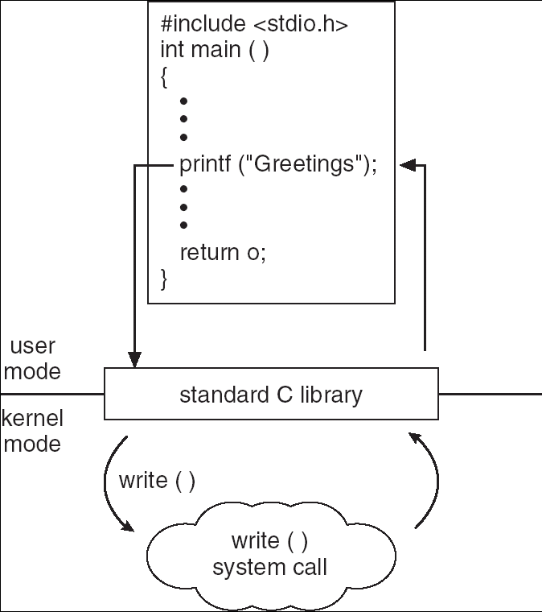
Standard C Library Example
C program invoking printf() library call, which calls the write() system call

Slide 17
System Call Parameter Passing
Often, more information is required than simply identity of desired system call
  Exact type and amount of information vary according to OS and call
Three general methods used to pass parameters to the OS
  Simplest: pass the parameters in registers
    In some cases, may be more parameters than registers
  Parameters stored in a block, or table, in memory, and address of block passed as a parameter in a register
    This approach taken by Linux and Solaris
  Parameters placed, or pushed, onto the stack by the program and popped off the stack by the operating system
  Block and stack methods do not limit the number or length of parameters being passed

Slide 18

Parameter Passing via Table

Slide 19
2.4 Types of System Calls

Slide 20
Five Major Categories
System calls can be grouped into five major categories:
  Process control
    Load, execute, end, abort, create process, get/set process attributes, wait for time/signal, allocate/free memory
  File management (manipulation)‏
    Create/delete/open/close/read/write a file, get/set file attributes
  Device management
    Request/release device, read/write data, get/set attributes
  Information maintenance
    Get/set time or date, get/set system data, get/set attributes for process/file/device
  Communications
    Create/delete connection, send/receive messages, attach/detach devices

Slide 21

Example of MS-DOS execution
(a) At system startup (b) running a program

Slide 22

Example of LINUX Running Multiple Programs

Slide 23
2.5 System Programs

Slide 24
System Program Categories
System programs provide a convenient environment for program development and execution. They can be divided into:
  File management (create, delete, copy, rename, print, list, etc.)‏
  Status information (date, time, memory, disk space, users, etc.)
  File modification (text editors, file search)
  Programming language support (compiler, linkers, interpreters)
  Program loading and execution (loaders)
  Communications (virtual links, send/receive messagesl)
  Application programs (web browsers, office suites)‏
Most users’ view of the operation system is defined by system programs, not the actual system calls
System programs provide a convenient environment for program development and execution
  Some of them are simply user interfaces to system calls; others are considerably more complex

Slide 25
2.6 Operating System Design and Implementation

Slide 26
Operating System Design and Implementation
Some approaches to operating system design have proven successful
Internal structure of different operating systems can vary widely
Start by defining goals and specifications
Affected by choice of hardware and type of system
User goals and System goals
  User goals – operating system should be convenient to use, easy to learn, reliable, safe, and fast
  System goals – operating system should be easy to design, implement, and maintain, as well as flexible, reliable, error-free, and efficient

Slide 27
Operating System Design and Implementation (Cont.)‏
Important principle to separate
Policy: What will be done?
Mechanism: How to do it?
The separation of policy from mechanism is a very important principle, it allows maximum flexibility if policy decisions are to be changed later

Slide 28
2.7 Operating System Structure

Slide 29
Simple Structure
MS-DOS – written to provide the most functionality in the least space
  Not divided into modules
  Although MS-DOS has some structure, its interfaces and levels of functionality are not well separated

Slide 30

MS-DOS Layer Structure

Slide 31
Layered Approach
In a layered approach, the operating system is divided into a number of layers (levels), each built on top of lower layers. The bottom layer (layer 0), is the hardware; the highest (layer N) is the user interface.
With modularity, layers are selected such that each uses functions (operations) and services of only lower-level layers

Slide 32

Layered Operating System

Slide 33
UNIX
Limited by hardware functionality, the original UNIX operating system had limited structuring. The UNIX OS consists of two separable parts
  The kernel
    Consists of everything below the system-call interface and above the physical hardware
    Provides the file system, CPU scheduling, memory management, and other operating-system functions; a large number of functions for one level
  Systems programs

Slide 34

UNIX System Structure

Slide 35
Microkernel System Structure
Moves as much from the kernel into “user” space
Communication takes place between user modules using message passing
Benefits:
  Easier to extend a microkernel
  Easier to port the operating system to new architectures
  More reliable (less code is running in kernel mode)‏
  More secure
Detriments:
  Performance overhead of user space to kernel space communication

Slide 36

Mac OS X Structure

Slide 37
Modules
Most modern operating systems implement kernel modules
  Uses object-oriented approach
  Each core component is separate
  Each talks to the others over known interfaces
  Each is loadable as needed within the kernel
Overall, similar to layers but more flexible

Slide 38

Solaris Modular Approach

